Slide 1
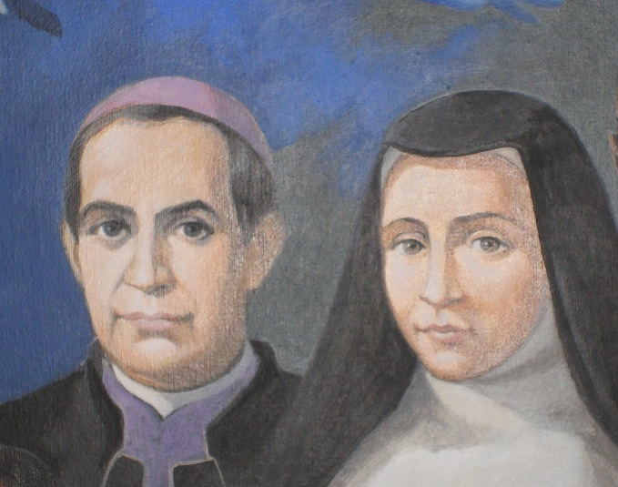
toward a common home World fraternity and solidarity
Synthesis meeting November 7, 2020
With Claret and Paris
28 th November 2020

Slide 2
Recalling OBJECTIVES
Continue to motivate a change in lifestyle to contribute to a "Global Ecology" that puts us on the way to a common home
Welcoming the invitation of the special anniversary of Laudato SI ’and the latest encyclical Fratelli tutti.
Make the prophetic commitment a reality and transforming Justice, Peace and Integrity of Creation, proposed by the XVII GC

Slide 3
…Towards a prophetic reading of our missionary vocation from Laudato SI ’and Fratelli tutti....
A strong invitation to keep ourselves in an attitude of discernment in the face of today's reality, to discover the signs of the Spirit that challenge us, and to respond from the charism.

Slide 4
We are all responsible of …
actively collaborate in the work of the Spirit

Slide 5
Three moments of reflection
Laudato SI’
Fratelli tutti
Response tracks

Slide 6
An integral ecological conversion of being interconnected.
Laudato SI’

Slide 7
Inhabiting the common home of being brothers and sisters without borders
Fratelli tutti
Open hearts, hands and minds are needed ...

Slide 8
Cultivate the mystical, contemplative and missionary attitude
Response tracks

Slide 9
It is the Spirit that…
guides and enlightens us in the discernment and fight against all forms of evil;
invites us to be prophets in our today as were Claret and Paris.

Slide 10
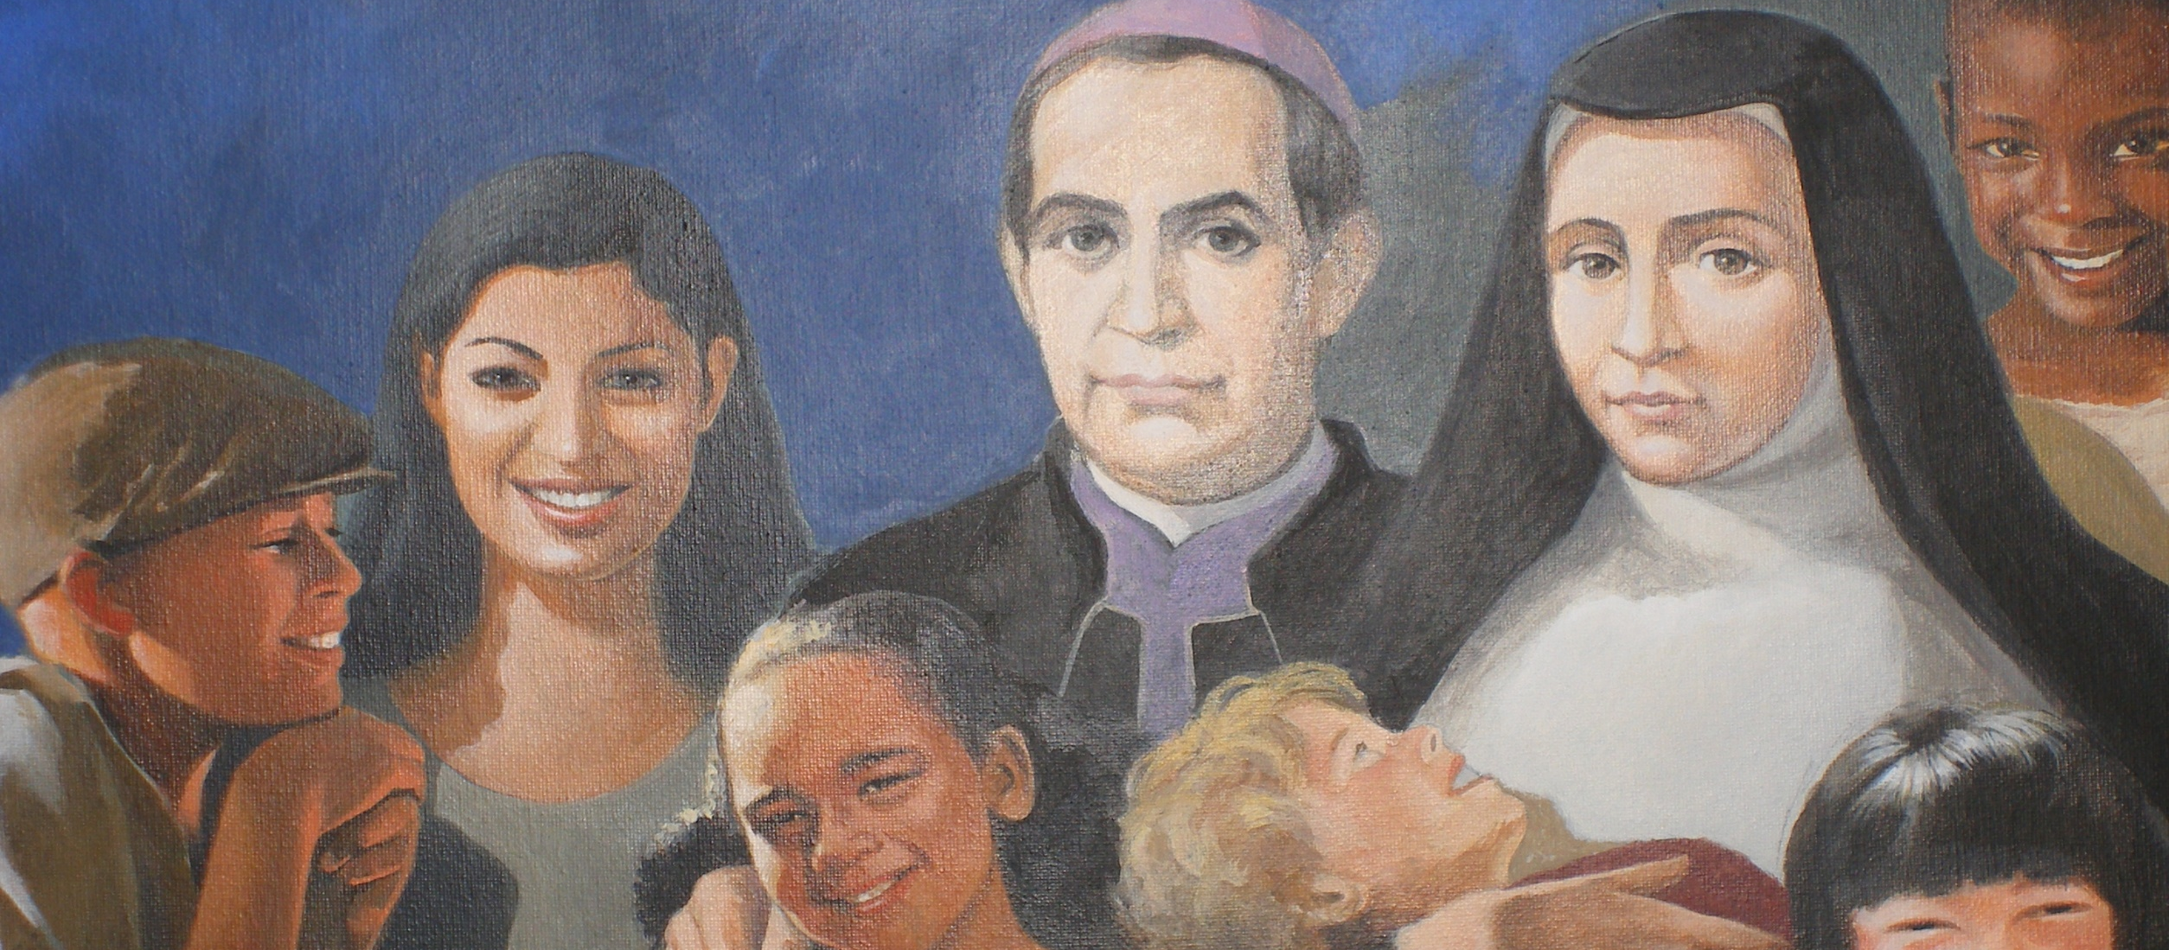
We are called to be instruments of Father God as were
Claret and Paris, so that our planet would be what He dreamed of when creating it
and respond to your project of peace, beauty and fullness » (LS 53)

