Slide 1
Managing Crucial Conversations
Letty Garcia
September 30, 2023

Slide 2
Agenda
Opening Prayer
Review Agenda
Communication Style and Impact
Exercise
Q &A

Slide 3
“Communication has the power to build bridges, to enable encounter and inclusion, and thus enrich society. How beautiful it is when people select their words and actions with care, in the effort to avoid misunderstandings, to heal wounded memories and to build peace and harmony.”
Message for World Communications Day 2016 – Pope Francis

Slide 4
Opening Prayer
Lord help us to listen with open hearts and minds, as we begin this session. Help us to learn something new today. Guide us, Lord, to learn the skills necessary to build healthy relationship relationships with our colleagues, friends, family and community as we follow your Son, Jesus.
Amen
Adapted from Kantor Institute. All rights reserved. Reproduction in any form, in whole or in part, is prohibited.
Notes:
Grace: that we find in communication a way to live in fellowship with God and others.

Slide 5
Goals of this Session
Equip you with a structural language to describe common patterns of interaction within others and your teams
Identify the implications of your dominant profile and understand the potential blind spots it creates
Provide insight into how individuals within your group /team might shift their behavior to help the group operate more effectively overall
Adapted from Kantor Institute. All rights reserved. Reproduction in any form, in whole or in part, is prohibited.
Notes:
The focus of your attention and kinds of topics, issues, and content toward which you naturally gravitate.
David Kantor’s theory of Structural Dynamics describes the interplay of structures within a communication system and provides compelling insight into how individuals and teams can operate more effectively together. His model, used for decades by psychologists, organizational development professionals, and interventionists to improve performance, is now broadly available through this suite of instruments and in his groundbreaking publication, Reading the Room¹.
For more information on Kantor’s structural dynamics, please visit www.kantorinstitute.com

Slide 6
Change Begins with ME
Understanding myself

Slide 7
Individual Behavioral Propensities
Because you spend most of your life interacting with others, it is essential to understand your own tendencies and to be able to recognize the tendencies of others.
Doing so, will help you both broaden your own behavioral repertoire – meaning that you can engage comfortably in a wider range of actions - and have greater tolerance for differences in the behavior of others
Individuals tend to adopt characteristic patterns of behavior which we call your Baseline Behavioral Propensities.
Adapted from Kantor Institute. All rights reserved. Reproduction in any form, in whole or in part, is prohibited.
Notes:
Behavioral Propensities drive behavior in terms of how you organize your relationships with others, the language patterns you are known for, and the most characteristic actions you take in face-to-face conversation

Slide 8
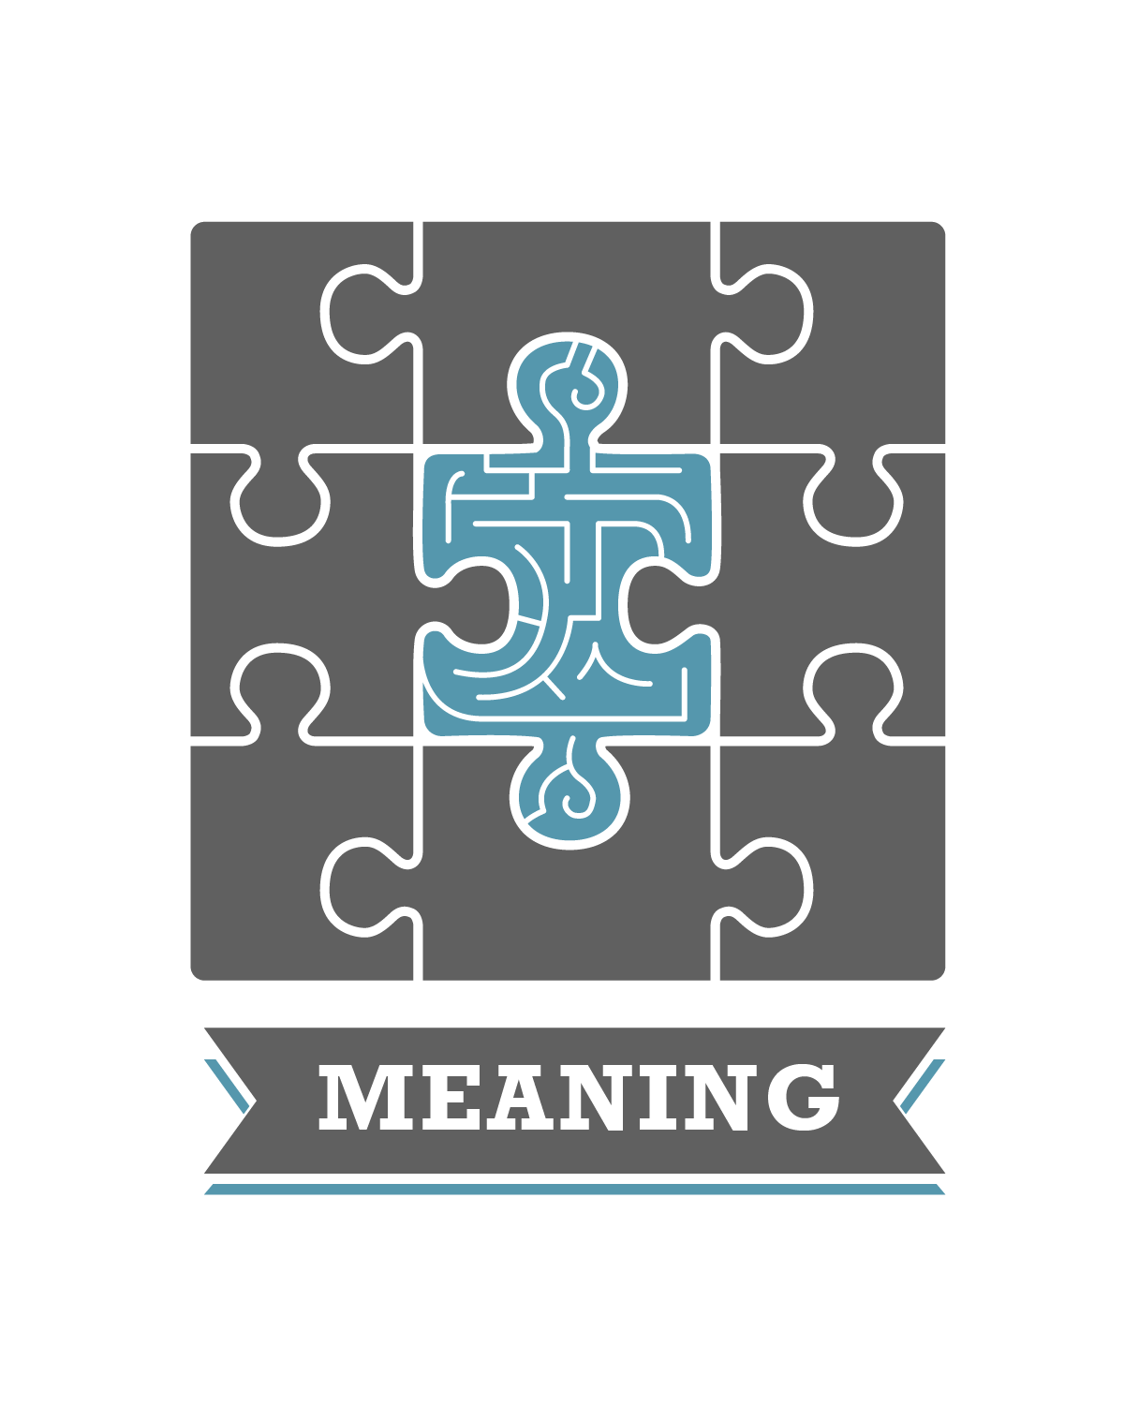
Communication Domains
Teams are known to emphasize a specific Communication Domain as being of primary importance, which is reflected in the content of their communication
Adapted from Kantor Institute. All rights reserved. Reproduction in any form, in whole or in part, is prohibited.
Notes:
Communication Propensities
Individuals tend to focus on certain kinds of issues and topics more frequently than others.
Communication propensities represent what you pay attention to when you are interacting with others, either Affect, Meaning or Power.
Because of your interest in these topics, the language that you use most frequently is reflective of your Communication Propensity.

Slide 9
The Affect Communication Domain
Characterized by… | Focus on relationships and trust Expression of emotion Taking care of one another
Strengths | Empathetic towards others, leading to strong relationships Watches out for the well-being of team members
Limitations | Can lack the influence needed to bring attention to Affect issues May repel those who are uncomfortable with the language of Affect
Adapted from Kantor Institute. All rights reserved. Reproduction in any form, in whole or in part, is prohibited.
Notes:
The language of Affect is about connection between people, particularly emotional.
Individuals with an Affect Propensity take special note of others’ well-being and how they react to what is being said.
They emphasize trust and motivation and try to provide a climate of warmth and caring.

Slide 10
The Power Communication Domain
Characterized by… | Relentless focus on completion High levels of productivity and output Keen awareness of time
Strengths | Tend to be highly influential as the engine for action Strong bias for action is viewed as a positive leadership attribute
Limitations | Can place more importance on completion than on quality Lack patience with those who focus on other domains
Adapted from Kantor Institute. All rights reserved. Reproduction in any form, in whole or in part, is prohibited.
Notes:
The language of Power is about accountability, competence and completion.
Individuals with a Power Propensity tend to speak in reference to specific goals and are highly conscious of time.
They enjoy crossing items off of their list and moving projects to closure.
Talents
You are very pro-active towards getting things done
You know how to involve others in the pursuit of an end goal
You make sure that everyone knows what they need to do
Traps
You may achieve false consensus by moving too quickly towards a decision
Your bias for action may cut short important discussions about people and ideas
The power and frequency of your ideas may inhibit others’ ability to contribute
Tips
Be mindful that everyone may not be ready to move forward on a decision as quickly as you are
Make room for others to contribute in ways that are different from your own
Actively solicit others’ feedback on their comfort with the plan of action

Slide 11
The Meaning Communication Domain
Characterized by… | Thirst for ideas and understanding Commitment to a higher mission Depth and quality of analysis
Strengths | Rigorous thinking leads to great ideas Excels at making sense of complexity and showing how disparate pieces fit together
Limitations | Commitment to a mission sometimes crosses over the line into righteousness Sometimes overanalyzes topics past the point of relevance
Adapted from Kantor Institute. All rights reserved. Reproduction in any form, in whole or in part, is prohibited.
Notes:
The language of Meaning is about thinking, logic and a sense of purpose. Individuals with a Meaning Propensity are concerned with “what we stand for” and with deeply understanding how things work.
They love exploring ideas and concentrating on the theoretical underpinnings of a discussion.
Talents
You’re very effective at building a case for a worthy idea
Others rely upon you to help bring lengthy debates to closure
You are seen as a reliable and important member of the team
Traps
Your orientation towards ideas may lead you to neglect issues of people or action
You are often seen as “taking sides” rather than remaining neutral in a debate
You bay be seen as too easily influenced by other’s ideas rather than generating your own strong point of view
Tips
Encourage others to support the ideas in which they believe
Start out looking

Slide 12
Caveats
The Kantor model gives you a common language for your own and others’ propensities.
No one mode of communication is better or worse than any other
Knowing your profile, you can more easily identify situations in which it serves you well and other times when it may hinder you.
The profile can help in identifying ways to expand your repertoire by experimenting with, and engaging in, behaviors less common to your profile.

Slide 13
Center of Gravity Exercise – Instructions
Step 1. Describe 1-3 conversations you had in the last 3 months
 | PERSONAL | PROFESSIONAL
MAJOR (High Stakes)
ROUTINE (Day to Day)
Notes:
Give them 3-5 minutes to fill this out. Quick.
Instruct them to put 3 bullets in each cell.
Pair and share the professional column and, if you are comfortable, the personal column. Share as much or as little as you want.
This gives them a sense of the range of adversity and it illustrates that despite differences in background and industry, the types and level of adversity are often very similar.
Then ask for observations in the big group. They’ll discuss things they found in common and how helpful it is to simply share adversity.
Then make the point that the routine ones are important for two reasons: they can drain and deplete our energy OR they can be practice opportunities– the daily events that enable us to practice the tools we’ll be discussing.
My personal examples:
No boarding pass and on standby for flight home.
DSL link not working.
Working with some senior colleagues to try
some new approaches in an MBA course.
After the pair and share, one option is to say:
Let’s project out over the next 5 years.
Is life likely to get simpler or more complex for you?
Is the pace of your work likely to accelerate or slow down?
Are challenges you’re handed likely to be easier or harder?
Overall, is life going to be more or less demanding?
Okay, so this is a snapshot of an escalating curve, and over the past 5 years, you’ve probably lived through an escalation in complexity, pace, difficulty, and demands.
Those who can deal with adversity faster and more constructively thrive. They can achieve more and the intensifying demands they experience are less depleting.
.
Draw this on the board , with dot in the middle (“you now”).and ask them to draw the curve backward five years and then forward five years. Then pair and share. Then ask: what’s the general trend line?
Past 5 years ←Now→Next 5 years
TIME
Adversity
I did this in June 2008. Not worth the time, and they ask too many questions trying to figure it out. In the future, I would draw it and draw the typical curve for a “high potential leader.

Slide 14
Center of Gravity Exercise – Instructions cont’d.
Step 2. Consider which type of predominant Communication Domain (affect, power, meaning). propensity you tended to use in the conversations you wrote about in the previous page.
Step 3. Pick your strongest domain and share with a partner – focusing on the impact:
When you are in a situation where this domain (affect, power, meaning) is very strong, how do you react?
What does it make you think and feel?”
What do you notice? What stands out to you here?
Affect Caring, Feelings, Emotions | Power Doing, Results, Efficiency | Meaning Why, How things fit, Purpose

Slide 15
What might be some implications of your dominant propensity on your Group/Team/Community
How do you see your profile “showing up” in your group thus far, or in your work or personal life?
What might you do to experiment to broaden your profile?
What might you do to experiment to broaden your profile in your group?
Notes:
Center of Gravity

Slide 16
Implication of the Communication Domain for Groups/Teams
Majority of Affect
Likely to experience…
Focus on relationships and trust; taking care of one another
Expression of emotion
May need to watch out for….
Can lack the influence needed to bring attention to affect issues
May repel those who are uncomfortable with the language of affect

Slide 17
Implication of the Communication Domain for Groups/Teams
Majority of Power
Likely to experience…
High focus on process to get things done
Jumping into action
Facts driven
May need to watch out for….
Group think
Tendency to ostracize or ignore those who are considered too “soft”

Slide 18
Implication of the Communication Domain for Groups/Teams
Majority of Meaning
Likely to experience…
Focus on the bigger picture
Thinking about the organization and have an enterprise mindset
May need to watch out for….
Spending too much time on asking “why?”/circular thinking
Analysis paralysis

Slide 19
Group propensities
Teams likewise tend to exhibit a profile of behaviors which are used and / or valued more than others. We call these Group Propensities
Group Propensities are typically driven by the profile of the leader or by a majority of team members who have similar profiles
Groups rarely have a broad enough behavioral repertoire to adapt their profile to changing contexts or new demands.
Because of this, groups tend to get stuck in a profile that meets some members’ needs and works well for some tasks but can’t always adapt as required
Adapted from Kantor Institute. All rights reserved. Reproduction in any form, in whole or in part, is prohibited.

Slide 20
What is required to have difficult conversations?
Trust
Psychological Safety
Active Listening
Empathy

Slide 21
What is Psychological Safety?
“Psychological safety is the belief that one will not be punished or humiliated for speaking up with ideas, questions, concerns o mistakes.”
Amy Edmondson
HBS Professor

Slide 22
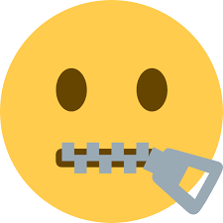
The dangers of low psychological safety
Avoidable Failure
Dangerous Silence

Slide 23
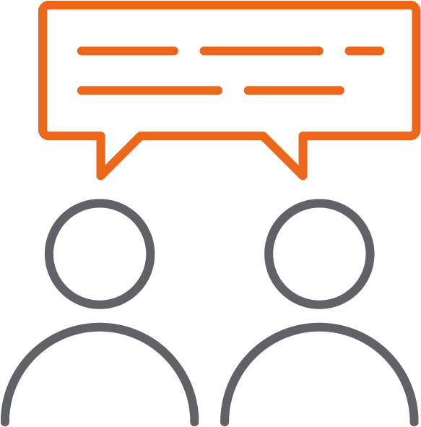
Four Dimensions of Psychological Safety
Inclusion and diversity
Willingness to help
Attitude to risk and failure
Open conversation

Slide 24
Active Listening: The Secret to Approaching Difficult Conversations

Slide 25
A thought experiment…
Part 1. Think about difficult conversation you were involved with that suffered from lots of problems (awkwardness, bad feelings)
Take 5 minutes to:
Write down a few notes about why it suffered these problems.
How did it impact you personally?
Part 2. Share with a partner.
Take 8 minutes in the Breakout
You will be paired with your original partner– share as much as you feel comfortable. Please share as much can without breaking confidentiality so that it is a fruitful conversation.

Slide 26
Difficult Conversations are almost never about getting the facts right. They are about conflicting perceptions, interpretations, and values.” ~Douglas Stone Difficult Conversations
Notes:
What’s so difficult about having “difficult conversations”?

Slide 27
Ladder of Inference
Source: Difficult Conversations: How to Discuss What Matters Most - Professional Leadership Institute
Notes:
Rethinking thinking - Trevor Maber - YouTube

Slide 28
What stops us from active listening?
Soundtrack of Thoughts
Brain works overtime looking in rear-view mirror to analyze, explain, and attribute blame
Source: Difficult Conversations: How to Discuss What Matters Most - Professional Leadership Institute

Slide 29
An Approach to a Learning Conversation
Advocacy
Inquiry
Source: Difficult Conversations: How to Discuss What Matters Most - Professional Leadership Institute

Slide 30
You can train yourself to do so by asking some of the following questions:
Self-Inquiry
Am I selective in listening to a conversation?
Am I interpreting the correct meaning of the data?
Why did I make this assumption?
Am I drawing the correct conclusions?
How can I act upon this information?
Is there another way to do this or to thin about this situation?
Am I selective in observing an interaction?
Source: Difficult Conversations: How to Discuss What Matters Most - Professional Leadership Institute
Notes:
The ladder of inference and its step-by-step framework can be used in every stage of your thought process to enable you to make better decisions. To improve your decision-making, you must know where you are on the ladder in your decision-making and adjust accordingly.
You can train yourself to do so by asking some of the following questions:
Am I selective in listening to a conversation? Am I selective in observing an interaction?
Am I interpreting the correct meaning of the data?
Why did I make this assumption?
Am I drawing the correct conclusions?
How can I act upon this information?
Is there another way to do this?
At each stage of the thought process, ask yourself what you’re thinking and why. Based on the situation, it’s preferable to occupy the lower rungs of the ladder of the inference or descend where possible. Here are some other ways to leverage the ladder of inference for better decision-making:
Expand your views and thought process to capture as much data as possible.
Assume your reasoning and thought process could have gaps or errors that you may overlook
Encourage conversations and explore other people's viewpoints by actively asking them about it.
Paraphrase (out loud) what you understand about what others say, so you can ensure that your understanding is correct.
Make clear the steps in your thinking to others so that they have a better understanding of how your own reasoning process works.
If you have to make any critical decisions, take time and think through the entire process before reaching a conclusion.

Slide 31
You can train yourself to do so by asking some of the following questions:
Inquire from the other person
Encourage conversations and explore other people's viewpoints by actively asking them about it.
Paraphrase (out loud) what you understand about what others say, so you can ensure that your understanding is correct.
Make clear the steps in your thinking to others so that they have a better understanding of how your own reasoning process works.
If you have to make any critical decisions, take time and think through the entire process before reaching a conclusion.
Notes:
The ladder of inference and its step-by-step framework can be used in every stage of your thought process to enable you to make better decisions. To improve your decision-making, you must know where you are on the ladder in your decision-making and adjust accordingly.
You can train yourself to do so by asking some of the following questions:
Am I selective in listening to a conversation? Am I selective in observing an interaction?
Am I interpreting the correct meaning of the data?
Why did I make this assumption?
Am I drawing the correct conclusions?
How can I act upon this information?
Is there another way to do this?
At each stage of the thought process, ask yourself what you’re thinking and why. Based on the situation, it’s preferable to occupy the lower rungs of the ladder of the inference or descend where possible. Here are some other ways to leverage the ladder of inference for better decision-making:
Expand your views and thought process to capture as much data as possible.
Assume your reasoning and thought process could have gaps or errors that you may overlook
Encourage conversations and explore other people's viewpoints by actively asking them about it.
Paraphrase (out loud) what you understand about what others say, so you can ensure that your understanding is correct.
Make clear the steps in your thinking to others so that they have a better understanding of how your own reasoning process works.
If you have to make any critical decisions, take time and think through the entire process before reaching a conclusion.

Slide 32
Let’s Go Back to Our thought experiment…
Part 1. Take five minutes to write down how you might have climbed the “ladder of inference” in this situation?
What could you have done different to prepare to have this conversation?
How might you have ‘slowed down’ your thinking to short circuit your moving up the ladder of inference?
Might there be one question you could have asked that may have allowed you to gather more data?
Part 2. Share with a partner.
Take 8 minutes in the Breakout
You will be paired with your original partner– share as much as you feel comfortable. Please share as much can without breaking confidentiality so that it is a fruitful conversation.

Slide 33
Closing Thoughts

Slide 34
EQ Across Cultures
Emotions vary tremendously across culture – both in terms of their expression and their meaning
Without detailed understanding of these emotional landscapes, crossing cultures can become a communication minefield.
Enthusiasm
Source: Molinsky
Notes:
Which emotions might be misinterpreted? EG Enthusiasm in Japan vs Argentina / US acceptable
American bosses can be surprised by the lack of “passion” or interest of their UK or Asian counterparts when, in fact, these folks may be quite interested but just show it differently
In reverse, individuals outside the US can be frustrated by how “superficial” Americans are when offering a big smile, handshake or hug, not necessarily realizing that these expressions may actually by quite genuine and authentic.

Slide 35
Why We Avoid Difficult Conversations?
People avoid difficult conversations because of the possible consequences. As humans, we are generally loss averse.
Thus, if the potential consequence comes with a risk of loss, even a small one, we will tend to avoid the situation.
However, leaving the situation the same is rarely an optimal solution. And in some cases, it can lead to exacerbated problems.
Source: Difficult Conversations: How to Discuss What Matters Most - Professional Leadership Institute

Slide 36
Beware of Accumulating Conversational Debt
Postponing critical conversations
Avoiding timely feedback
Making hard decisions
Passive Aggressiveness
Source: Emily Truelove, PhD. HBS Professor
Notes:
When you make expedient short-term decisions with expensive long-term consequences.

Slide 37
Questions?

Slide 38
Closing Prayer
Lord continue to open our hearts so we can truly listen to one another. Grant us the gift of empathy to see through the eyes of others and understand their joys and sorrows. Bless us, Father, with eloquence and wisdom so that we may share Your love and light with those around us.
Amen
Adapted from Kantor Institute. All rights reserved. Reproduction in any form, in whole or in part, is prohibited.
Notes:
Grace: that we find in communication a way to live in fellowship with God and others.

Slide 39
Suggested Readings
Crucial Conversations by Kerry Patterson
Difficult Conversations: How to Discuss What Matters Most by Douglas Stone, Bruce Patton, Sheila Heen
Resolving Conflict: Ten Steps for Turning Negatives to Positives by Harold Scharlatt
On Organizational Learning by Chris Argys

